Slide 1
Instructor Information
Dr. Sayanti Roy
Email: roy203@purdue.edu
Phone: 219-989-2479
Office Hours: Tuesday and Thursday 3:30 – 4:30 pm or by appointment
Office Location: CLO 386
Lab Location : CLO 336 [if she is not in her office]
Class will transition to a remote format after Spring Break, as Dr. Roy will be undergoing a medical procedure.

Slide 2
Meeting Time and Location
Lecture
Tuesday and Thursday: 2:00 pm – 3:15 pm.
Hammond Campus — Classroom Office — Room 340

Slide 3
Prerequisites
Students should have some prior python programming experience and some knowledge of Data Structures and Linear Algebra.
I WANT YOU ALL TO KNOW THE Basics of the FOLLOWING Python:
Numpy
Scipy
Arrays
Lists
Matrices
Basic Operation like And, Or
Loops and Conditions
Classes, functions
Matplotlib

Slide 4
Course Format
Lecture
Programming concepts will be taught in class using Python (mostly)
Assignments and Project will be solved through Python
No lab

Slide 5
Learning Materials
Books :
Artificial Intelligence: A Modern Approach, 4th edition Published by Pearson Stuart Russell & Peter Norvig, ISBN-13: 9780134610993 under Instructional Materials Access. [AIMA Python for code].
Whatever done in class
OTHER MATERIALS : UC Berkley + Stranford : GitHub Materials

Slide 6
Course Description
This course introduces intelligent agent autonomous systems that perceive their environment, reason about goals, and take actions to maximize performance. Students will study decision-making under uncertainty, learning agents, and multi-agent interaction. The course covers foundational concepts and emphasizes hands-on implementation of agents in simulated and real-world environments.
Topics include rational agents, search and planning, Markov Decision Processes, and reinforcement learning. The course also covers partially observable environments, agent communication and coordination, adversarial and cooperative multi-agent systems, and ethical considerations in agent design. Students will design, implement, and evaluate single and multiagent agents through programming assignments and a project using modern AI frameworks.

Slide 7
CAREER OPTIONS AI AGENTS
DATA SCIENCE
ROBOTICS
AI ETHICS
UX
HCI,HRI WITH AI
AI ENGINEER …..

Slide 8
Assignments and Grades
Your grade will be determined based on the following:
•Participation and Engagement: Students are expected to attend all class meetings.
•Quizzes (25% of Total Grade): Short assessments based on readings and class discussions, designed to reinforce key concepts.
•Assignments (50% of Total Grade): Includes programming assignments. Assignments will be due on Sunday 11:59pm. Late assignments will be accepted with 10% penalty per day late on the assignment.
•Final Project (25% of the Total Grade): A group project covering course content.
Your grade will be calculated based on the following scale:
Total Points Earned Letter Grade
93–100% A
90–92.9% A–
87–89.9% B+
83–86.9% B
80–82.9% B–
77–79.9% C+
73–76.9% C
70–72.9% C–
67–69.9% D+
63–66.9% D
60–62.9% D–
Below 60.0 F

Slide 9
Course Outcome
By the end of the course, students will be able to:
• Model environments
• Select appropriate agent architectures,
• Implement learning and planning algorithms,
• Critically analyze the behavior of agents in complex and dynamic settings.

Slide 10
UNIVERSITY POLICIES and SUPPORT
Please go through the syllabus for plagiarism, academic integrity, university policies, emotional & financial Support and other academic support.

Slide 11
AI Background ?
Any idea about agents ?
Your learning expectations ?

Slide 12
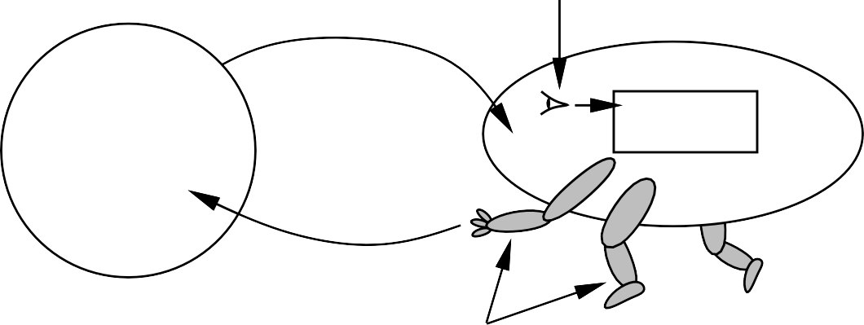
AGENTS [Robots, Generative AI tools etc.]
sensors
percepts
?
agent
environment
actions
Actuators
An agent is anything that can be viewed as perceiving its environment through sensors and acting upon that environment through actuators. Human agent [sense organs] vs Robot agent [cameras, IR range finders, motors as actuators ] vs software agent [key inputs, file contents, network packets as sensory inputs , display on the screen , writing files, or sending network packets].
E.g. Human, Robot, Software Agents etc.
Simple agents, Goal Based agents, Utility agent.
Fully observable, Partially Observable, Stochastic…

Slide 13
AI Agents course with LLM focus[other Universities]
https://github.com/barghouthi/ai-agents?tab=readme-ov-file
https://rdi.berkeley.edu/llm-agents/f24
https://cs329a.stanford.edu/index.html

Slide 14
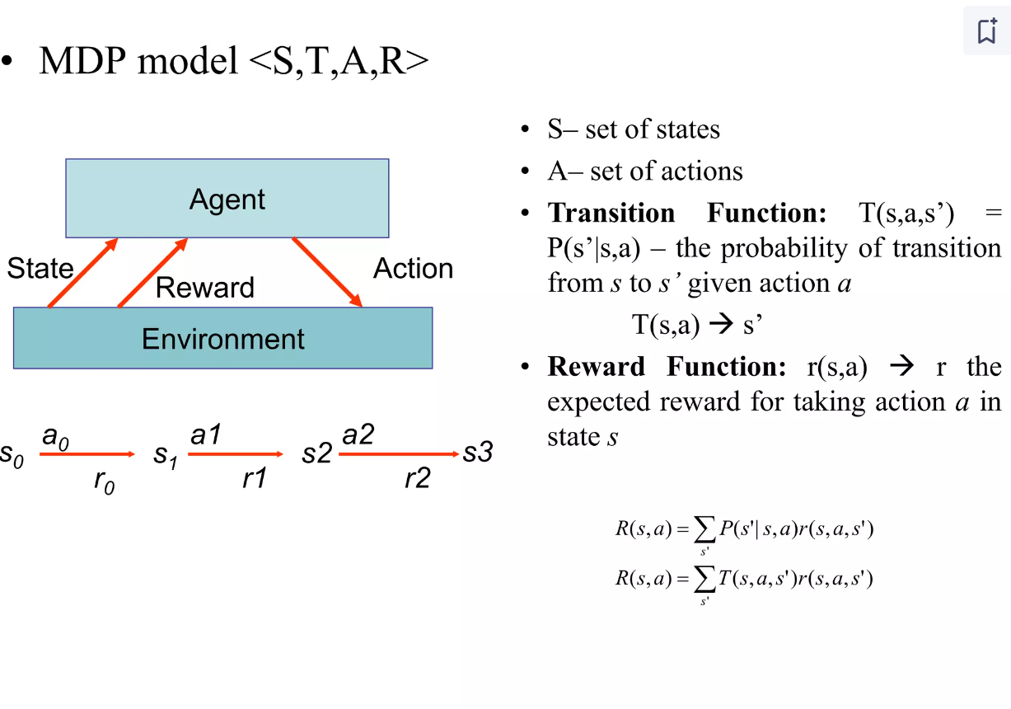
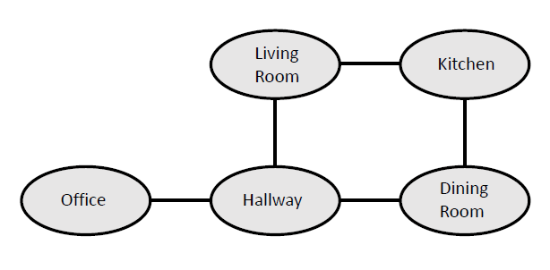
E.g. Vacuum cleaning agent

Slide 15
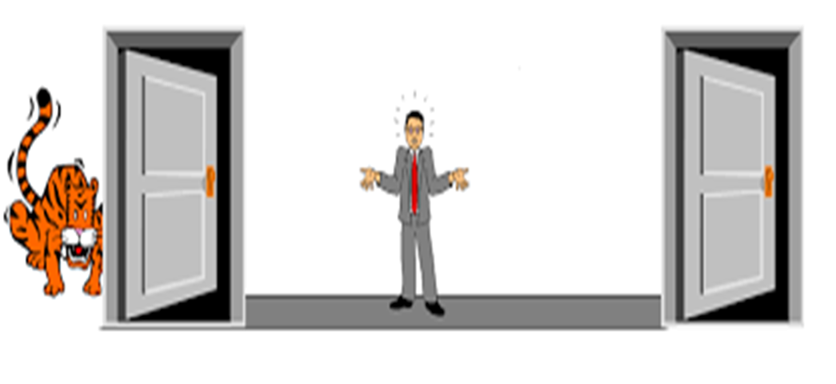
The agent is tasked with escaping from a room. There are two doors leading out of the room. Behind one of the doors is a tiger, and behind the other is sweet, sweet freedom. If the agent opens the door and finds the tiger, it gets eaten (and receives a reward of -100). If the agent opens the other door, it escapes and receives a reward of 10. The agent can also listen. Listening gives a noisy measurement of which door the tiger is hiding behind. The agent receives a cost of -1 for listening.

Slide 16
There are two main states:
State 1 (S1): The agent is in the room with two doors (Door A and Door B), and it needs to make a decision.
State 2 (S2): The agent listens to the doors.
2. Actions:
Action 1 (Open Door A): The agent opens Door A.
Action 2 (Open Door B): The agent opens Door B.
Action 3 (Listen): The agent listens to determine the tiger's location.
3. Rewards:
If the agent opens a door and finds the tiger: Reward = -100.
If the agent opens the door with freedom: Reward = +10.
If the agent listens: Reward = -1, regardless of whether the agent gets the correct or incorrect reading.
4. Transitions:
Listening (Action 3) leads to a state where the agent receives a noisy signal, and the location of the tiger may be correctly or incorrectly identified.
Opening Door A (Action 1) or Opening Door B (Action 2) has two outcomes:
The door could have the tiger (leading to a reward of -100).
The door could have freedom (leading to a reward of +10).

Slide 17
What does the diagram or policy graph look like ?
How to program this ?
https://zoo.cs.yale.edu/classes/cs470/materials/hws/aima/mdp.html

Slide 18
Omniscience != Rationality != Perfection
Omniscience is not possible in the real world
Rationality is not the same as perfection. Information gathering—is an important part of rationality.
Rationality maximizes expected performance, while perfection maximizes actual performance.

Slide 19
Performance measures
The sequence of actions performed by the agent is evaluated through performance measure.
It may be an external human input, robot’s own learning.
Autonomy improves performance as it relies more on current scene perception and learning than previous knowledge of the environment. An agent should know how to compensate for partial or incorrect prior knowledge – good modelling is important !!

Slide 20
PEAS (Performance, Environment, Actuators, Sensors)
Rationality of an agent, depends on performance measure, the environment, and the agent’s actuators and sensors. → task environment.

Slide 21
PEAS Vacuum cleaner Robot
Performance: cleanness, efficiency: distance traveled to clean, battery life, security.
Environment: room, table, wood floor, carpet, different obstacles.
Actuators: wheels, different brushes, vacuum extractor, dirt disposal tube.
Sensors: camera, dirt detection sensor, bump sensors, infrared wall sensors

Slide 22
PEAS : Self Driving Car
Performance: ?
Environment: ?
Actuators: ?
Sensors: ?

Slide 23
PEAS : Self Driving Car
Performance: correct destination; minimizing fuel consumption and wear and tear; minimizing the trip time or cost; minimizing violations of traffic laws and disturbances to other drivers; maximizing safety and passenger comfort, maximizing profits.
Environment: traffic, pedestrians, stray animals, road works, police cars, puddles, and potholes.
Actuators: control over the engine through the accelerator and control over steering and braking.
Sensors: speedometer, cameras, GPS, engine sensors, touch screen.

Slide 24
Types of Agent
Four basic types in order of increasing generality:
Simple reflex agents
Model-based reflex agents
Goal-based agents
Utility-based agents
All of which can be generalized into learning agents that can improve their performance and generate better actions.

Slide 25
Simple Reflex Agent
Simple reflex agents select an action based on the current state
only ignoring the percept history.
Simple but limited.
Can only work if the environment is fully observable, that is the correct action is based on the current percept only.

Slide 26
Model-based reflex agents
Handle partial observability by keeping track of the part of the world it can’t see now.
Internal state depending on the percept history (best guess).
Model of the world based on (1) how the world evolves independently from the agent, and (2) how the agent actions affects the world.

Slide 27
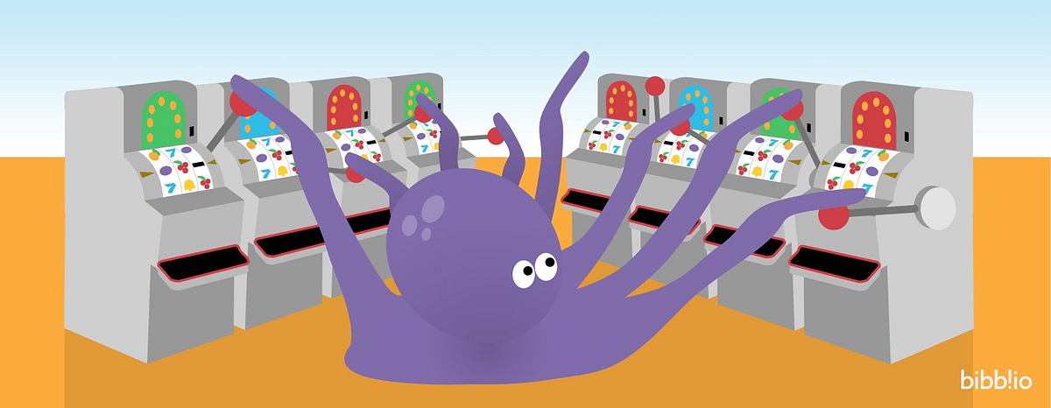
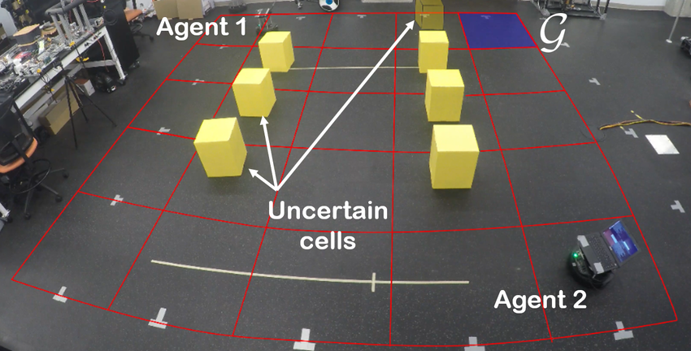
Goal-based Agents
Knowing the current state of the environment is not enough.
The agent needs some goal information.
Agent program combines the goal information with the environment model to choose the actions that achieve that goal.
Consider the future with “What will happen if I do A?”
Flexible as knowledge supporting the decisions is explicitly represented and can be modified.

Slide 28
Utility-based agents
Sometimes achieving the desired goal is not enough.
We may look for quicker, safer, cheaper trip to reach a destination.
Agent happiness should be taken into consideration. We call it utility.
A utility function is the agent’s performance measure. Because of the uncertainty in the world, a utility agent choses the action that maximizes the expected utility.

Slide 29
Task environment in AI is vast !!
FULLY OBSERVABLE
PARTIALLY OBSERVABLE
SINGLE-AGENT
MULTIAGENT
Deterministic
Nondeterministic
EPISODIC
SEQUENTIAL
STATIC
DYNAMIC
DISCRETE
CONTINUOUS
Known
Unknown

Slide 30
FULLY OBSERVABLE ENVIRONMENT
If an agent’s sensors give it access to the complete state of the environment at each point in time, then we say that the task environment is fully observable.
A task environment is effectively fully observable if the sensors detect all aspects that are relevant to the choice of action; relevance, in turn, depends on the performance measure.
Fully observable environments are convenient because the agent need not maintain any internal state to keep track of the world.

Slide 31
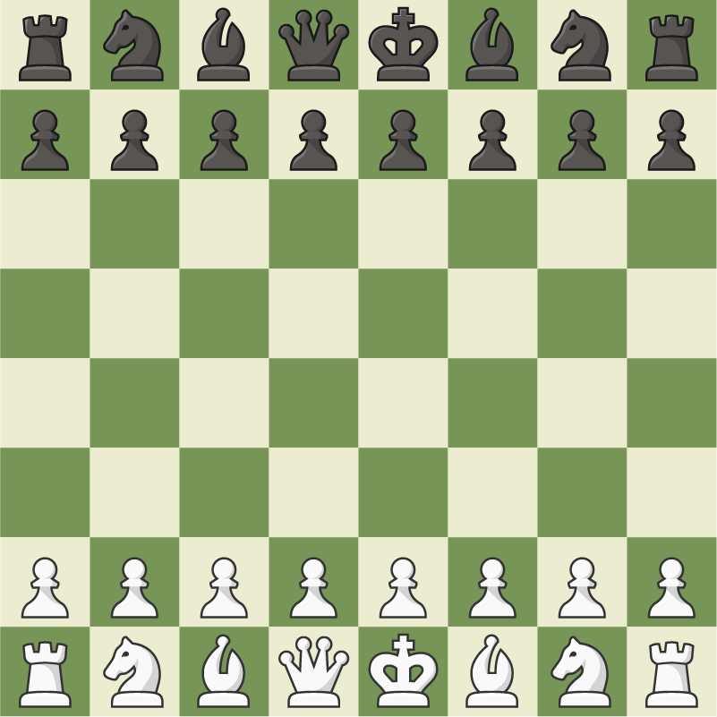

Slide 32
PARTIALLY OBSERVABLE ENVIRONMENT
An environment might be partially observable because parts of the state are simply missing from the sensor data. E.g. Cars (although road is fully observable), poker

Slide 33
SINGLE-AGENT ENVIRONMENT
Environment involves one agent.
For example, a vacuum cleaner cleaning a room.

Slide 34
MULTI AGENT ENVIRONMENT
Involves multiple agents (at least two).
Chess (agent-human, human-human, agent_a – agent_b)
Robots in warehouse, self driving cars

Slide 35
COMPETITIVE ENVIRONMENT
Agent trying to maximize their own performance while minimizing the performance of another agent.
Always a multi agent scenario.
Although behavior is competitive, but sometimes considered rational.
E.g. Chess

Slide 36
COOPERATIVE ENVIRONMENT
Agents helping each other to succeed.
Agents' actions are usually considered rational.
E.g. Cars on the road.

Slide 37
DETERMINISTIC ENVIRONMENT
If the next state of the environment is completely determined by the current state and the action executed by the agent(s), then we say the environment is deterministic.
Is always fully observable and lesser to no chances of uncertainties.
E.g. Vacuum cleaner.

Slide 38
NON DETERMINSTIC ENVIRONMENT
If the next state of the environment is not completely determined by the current state and the action executed by the agent(s), then we say the environment is nondeterministic.
Usually Partially Observable and filled with uncertainties.
E.g. cars
Real world scenarios are mostly non-deterministic due to complexities involved.
If the possibilities listed are quantified, we call them “stochastic”.

Slide 39
EPISODIC ENVIRONMENT
In an episodic task environment, the agent’s experience is divided into atomic episodes. In each episode the agent receives a percept and then performs a single action.
Crucially, the next episode does not depend on the actions taken in previous episodes.
Simple Agents used.
E.g. Sorting/Classification task performed by factory robots.

Slide 40
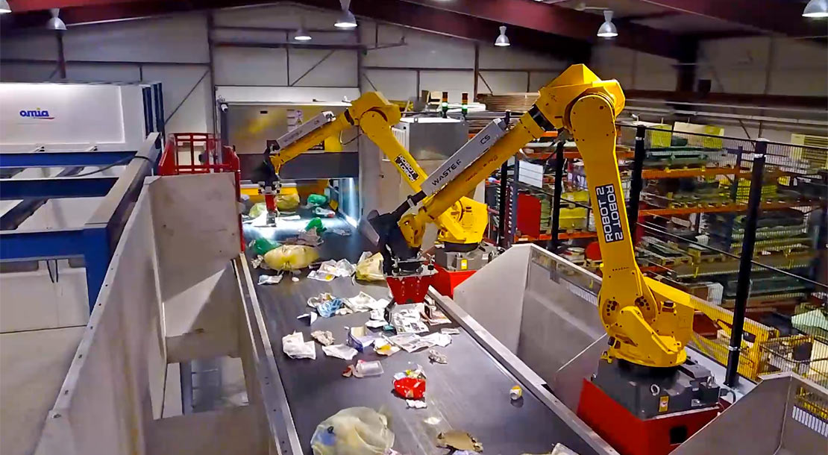

Slide 41
SEQUENTIAL ENVIRONMENT
In sequential environments, on the other hand, the current decision could affect all future decisions. Environment is more complex than episodic.
Chess, Cars

Slide 42
STATIC ENVIRONMENT
Environment does not change with the passage of time.
E.g. Crossword puzzles
Static environments are easy to deal with because environment does not change when the agent is deciding on an action, nor need it worry about the passage of time.
But agents' performance measure can change with time.

Slide 43
DYNAMIC ENVIRONMENT
Dynamic environment changes with time and the agent needs to act on it.
Cars, Chess
Agents' performance score can change.

Slide 44
DISCRETE ENVIRONMENT
Consists of a finite number of states and agents have distinct finite number of actions.
Chess, tic-tac

Slide 45
CONTINUOS ENVIRONMENT
The environment can have an infinite number of states and infinite possible actions.
Car environment is a continuous-state and continuous-time problem: the speed and location of a car and of the other cars sweep through a range of continuous values and do so smoothly over time.

Slide 46
KNOWN ENVIRONMENT
Known environment can be partially observable.
Solitaire card games, I know the rules but am still unable to see the cards that have not yet been turned over.

Slide 47
UNKNOWN ENVIRONMENT
Environment may be fully observable but unknown
Player learning Chess

Slide 48
Hardest Problem
The hardest case is partially observable, multiagent, nondeterministic, sequential, dynamic, continuous, and unknown.
Autonomous Driving

Slide 49
Problem Solving Agents
One kind of goal-based agent called a problem-solving agent. Problem-solving agents use atomic representations that is, states of the world are considered as wholes, with no internal structure visible to the problem-solving algorithms.
Goal-based agents that use more advanced factored or structured representations are usually called planning agents.
We will see several uninformed search algorithms—algorithms that are given no information about the problem other than its definition. Although some of these algorithms can solve any solvable problem, none of them can do so efficiently.
Informed search algorithms, on the other hand, can do quite well given some guidance on where to look for solutions.

Slide 50
Goal Formulation
Intelligent agents are supposed to maximize their performance measure.
Goals help organize behavior by limiting the objectives that the agent is trying to achieve and hence the actions it needs GOAL FORMULATION to consider.
Goal formulation, based on the current situation and the agent’s performance measure, is the first step in problem solving. We will consider a goal to be a set of world states—exactly those states in which the goal is satisfied. The agent’s task is to find out how to act, now and in the future, so that it reaches a goal state.

Slide 51
Problem Formulation
Problem formulation is the process of deciding what actions and states to consider, given a goal.
If the agent has no additional information—i.e., if the environment is unknown, then it is has no choice but to try one of the actions at random.

Slide 52
Problem Formulation
In general, an agent with several immediate options of unknown value can decide what to do by first examining future actions that eventually lead to states of known value.
To be more specific about what we mean by “examining future actions,” we have to be more specific about properties of the environment.

Slide 53
Problem Formulation
We assume that the environment is observable, so the agent always knows the current state. We also assume the environment is discrete, so at any given state there are only finitely many actions to choose from.
We will assume the environment is known, so the agent knows which states are reached by each action. Finally, we assume that the environment is deterministic, so each action has exactly one outcome.

Slide 54
Problem Formulation
Of course, conditions are not always ideal .
Under these assumptions, the solution to any problem is a fixed sequence of actions.
“Of course!” one might say, “What else could it be?” Well, in general it could be a branching strategy that recommends different actions in the future depending on what percepts arrive.
Fortunately, if the agent knows the initial state and the environment is known and deterministic, it knows exactly where it will be after the first action and what it will perceive. Since only one percept is possible after the first action, the solution can specify only one possible second action, and so on.

Slide 55
Problem Formulation
SEARCH The process of looking for a sequence of actions that reaches the goal is called search.
SOLUTION A search algorithm takes a problem as input and returns a solution in the form of an action sequence. Once a solution is found, the actions it recommends can be carried out. This
EXECUTION is called the execution phase. Thus, we have a simple “formulate, search, execute” design for the agent,
After formulating a goal and a problem to solve, the agent calls a search procedure to solve it. It then uses the solution to guide its actions, doing whatever the solution recommends as the next thing to do—typically, the first action of the sequence—and then removing that step from the sequence. Once the solution has been executed, the agent will formulate a new goal.

Slide 56
Problem Formulation
Notice that while the agent is executing the solution sequence it ignores its percepts when choosing an action because it knows in advance what they will be.
An agent that carries out its plans with its eyes closed, so to speak, must be quite certain of what is going OPEN-LOOP on.
Control theorists call this an open-loop system, because ignoring the percepts breaks the loop between agent and environment.

Slide 57
Problem Formulation
A problem can be defined formally by five components:
INITIAL STATE The initial state that the agent starts in.
A description of the possible actions available to the agent. Given a particular state s, ACTIONS(s) returns the set of actions that can be executed in s.
A description of what each action does; the formal name for this is the transition TRANSITION MODEL model, specified by a function RESULT(s, a) that returns the state that results from SUCCESSOR doing action a in state s. We also use the term successor to refer to any state reachable from a given state by a single action.

Slide 58
Problem Formulation
RESULT
STATE SPACE Together, the initial state, actions, and transition model implicitly define the state space of the problem—the set of all states reachable from the initial state by any sequence.
GRAPH of actions. The state space forms a directed network or graph in which the nodes

